Slide 1
Algorithms and Data Structures
Simonas Šaltenis
Nykredit Center for Database Research
Aalborg University
simas@cs.auc.dk

Slide 2
Administration
People
  Simonas Šaltenis
  Søren Holbech Nielsen
  Jan Eliasen
Home page http://www.cs.auc.dk/~simas/ad02
Check the homepage frequently!
Course book “ Introduction to Algorithms”, 2.ed Cormen et al.
Lectures, B3-104, 10:15-12:00, Mondays and Thursdays

Slide 3
Administration (2)
Exercise classes at 8:15 before the lectures!
Exam: SE course, written
Troubles
  Simonas Šaltenis
  E1-215
  simas@cs.auc.dk

Slide 4
What is it all about?
Solving problems
  Get me from home to work
  Balance my budget
  Simulate a jet engine
  Graduate from AAU
To solve problems we have procedures, recipes, process descriptions – in one word Algorithms

Slide 5
Data Structures and Algorithms
Algorithm
  Outline, the essence of a computational procedure, step-by-step instructions
Program – an implementation of an algorithm in some programming language
Data structure
  Organization of data needed to solve the problem

Slide 6
History
Name: Persian mathematician Mohammed al-Khowarizmi, in Latin became Algorismus
First algorithm: Euclidean Algorithm, greatest common divisor, 400-300 B.C.
19th century – Charles Babbage, Ada Lovelace.
20th century – Alan Turing, Alonzo Church, John von Neumann

Slide 7





Overall Picture
Using a computer to help solve problems
  Designing programs
    architecture
    algorithms
  Writing programs
  Verifying (Testing) programs
Data Structure and Algorithm Design Goals
Implementation Goals
Robustness
Reusability
Correctness
Efficiency
Adaptability

Slide 8
Overall Picture (2)
This course is not about:
  Programming languages
  Computer architecture
  Software architecture
  Software design and implementation principles
    Issues concerning small and large scale programming
We will only touch upon the theory of complexity and computability

Slide 9
Algorithmic problem
Specification of output as a function of input
Specification of input
?
  Infinite number of input instances satisfying the specification. For example:
    A sorted, non-decreasing sequence of natural numbers. The sequence is of non-zero, finite length:
      1, 20, 908, 909, 100000, 1000000000.
      3.

Slide 10

Algorithmic Solution
Input instance, adhering to the specification
Algorithm
Output related to the input as required
  Algorithm describes actions on the input instance
  Infinitely many correct algorithms for the same algorithmic problem

Slide 11

Example: Sorting
INPUT
sequence of numbers
OUTPUT
a permutation of the
sequence of numbers
Sort
a₁, a₂, a₃,….,a_{n}
b₁,b₂,b₃,….,b_{n}
2 5 4 10 7
2 4 5 7 10
Correctness (requirements for the output)
For any given input the algorithm halts with the output:
  b₁ < b₂ < b₃ < …. < b_{n}
  b₁, b₂, b₃, …., b_{n} is a permutation of a₁, a₂, a₃,….,a_{n}
Running time
Depends on
  number of elements (n)
  how (partially) sorted
  they are
  algorithm

Slide 12
Insertion Sort
A
3
4
6
8
9
7
2
5
1
1
j
n
i
Strategy
Start “empty handed”
Insert a card in the right
position of the already sorted
hand
Continue until all cards are
inserted/sorted
INPUT: A[1..n] – an array of integers
OUTPUT: a permutation of A such that A[1]≤ A[2]≤ …≤A[n]
for j←2 to n
do key←A[j]
Insert A[j] into the sorted sequence A[1..j-1]
i←j-1
while i>0 and A[i]>key
do A[i+1]←A[i]
i--
A[i+1]←key

Slide 13
Pseudo-code
A la Pascal, C, Java or any other imperative language:
  Control structures (if then else, while and for loops)
  Assignment (←)
  Array element access: A[i]
  Composite type (record or object) element access: A.b (in CLRS, b[A])
  Variable representing an array or an object is treated as a pointer to the array or the object.

Slide 14
Analysis of Algorithms
Efficiency:
  Running time
  Space used
Efficiency as a function of input size:
  Number of data elements (numbers, points)
  A number of bits in an input number

Slide 15
The RAM model
Very important to choose the level of detail.
The RAM model:
  Instructions (each taking constant time):
    Arithmetic (add, subtract, multiply, etc.)
    Data movement (assign)
    Control (branch, subroutine call, return)
  Data types – integers and floats

Slide 16


Analysis of Insertion Sort
Time to compute the running time as a function of the input size
for j←2 to n
do key←A[j]
Insert A[j] into the sorted sequence A[1..j-1]
i←j-1
while i>0 and A[i]>key
do A[i+1]←A[i]
i--
A[i+1]:=key
cost
c₁
c₂
0
c₃
c₄
c₅
c₆
c₇
times
n
n-1
n-1
n-1
n-1

Slide 17
Best/Worst/Average Case
Best case: elements already sorted → t_{j}=1, running time = f(n), i.e., linear time.
Worst case: elements are sorted in inverse order
→ t_{j}=j, running time = f(n²), i.e., quadratic time
Average case: t_{j}=j/2, running time = f(n²), i.e., quadratic time

Slide 18
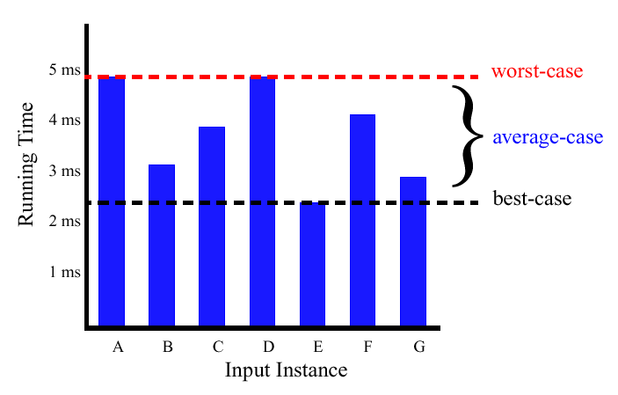
Best/Worst/Average Case (2)
  For a specific size of input n, investigate running times for different input instances:
6n
5n
4n
3n
2n
1n

Slide 19
Best/Worst/Average Case (3)
  For inputs of all sizes:
worst-case
6n
average-case
5n
best-case
Running time
4n
3n
2n
1n
1 2 3 4 5 6 7 8 9 10 11 12 …..
Input instance size

Slide 20
Best/Worst/Average Case (4)
Worst case is usually used:
  It is an upper-bound and in certain application domains (e.g., air traffic control, surgery) knowing the worst-case time complexity is of crucial importance
  For some algorithms worst case occurs fairly often
  The average case is often as bad as the worst case
  Finding the average case can be very difficult

Slide 21
That’s it?
Is insertion sort the best approach to sorting?
Alternative strategy based on divide and conquer
MergeSort
  sorting the numbers <4, 1, 3, 9> is split into
  sorting <4, 1> and <3, 9> and
  merging the results
  Running time f(n log n)

Slide 22
Example 2: Searching
INPUT
sequence of numbers (database)
a single number (query)
OUTPUT
an index of the found number or NIL
a₁, a₂, a₃,….,a_{n}; q
j
2 5 4 10 7; 5
2
2 5 4 10 7; 9
NIL

Slide 23
Searching (2)
INPUT: A[1..n] – an array of integers, q – an integer.
OUTPUT: an index j such that A[j] = q. NIL, if ∀j (1≤j≤n): A[j] ≠ q
j←1
while j ≤ n and A[j] ≠ q
do j++
if j ≤ n then return j
else return NIL
Worst-case running time: f(n), average-case:
f(n/2)
We can’t do better. This is a lower bound for the problem of searching in an arbitrary sequence.

Slide 24
Example 3: Searching
INPUT
sorted non-descending sequence of numbers (database)
a single number (query)
OUTPUT
an index of the found number or NIL
a₁, a₂, a₃,….,a_{n}; q
j
2 4 5 7 10; 5
2
2 4 5 7 10; 9
NIL

Slide 25
Binary search
Idea: Divide and conquer, one of the key design techniques
INPUT: A[1..n] – a sorted (non-decreasing) array of integers, q – an integer.
OUTPUT: an index j such that A[j] = q. NIL, if ∀j (1≤j≤n): A[j] ≠ q
left←1
right←n
do
j←(left+right)/2
if A[j]=q then return j
else if A[j]>q then right←j-1
else left=j+1
while left<=right
return NIL

Slide 26
Binary search – analysis
How many times the loop is executed:
  With each execution the difference between left and right is cult in half
    Initially the difference is n
    The loop stops when the difference becomes 0
  How many times do you have to cut n in half to get 1?
  lg n

Slide 27
The Goals of this Course
The main things that we will try to learn in this course:
  To be able to think “algorithmically”, to get the spirit of how algorithms are designed
  To get to know a toolbox of classical algorithms
  To learn a number of algorithm design techniques (such as divide-and-conquer)
  To learn reason (in a formal way) about the efficiency and the correctness of algorithms

Slide 28
Syllabus
Introduction (1)
Correctness, analysis of algorithms (2,3,4)
Sorting (1,6,7)
Elementary data structures, ADTs (10)
Searching, advanced data structures (11,12,13,18)
Dynamic programming (15)
Graph algorithms (22,23,24)
Computational Geometry (33)
NP-Completeness (34)

Slide 29
Next Week
Correctness of algorithms
Asymptotic analysis, big O notation
Some basic math revisited

